Slide 1



Data
Application
View
Removes the knowledge of the data stores from the actual logic of the application
Removes the knowledge of the UI from the actual logic of the application
DataManager
LogicManager
ScreenManager
Encapsulates the behavior of the application
WinForms
GUI
WPF User
Controls
IDataManagementPolicy
IDataAccessorStrategy
Application Configuration Settings
IDisplayStrategy
These are strategies which abstract knowledge of data stores
These are strategies which abstract knowledge of UI elements
Data
Provides settings to configure which strategies are used by the application
ASP.NET
GUI
Silverlight User
Controls

Slide 2
Save all on edit
Save individual on edit
Save changes manually
Add
Update
Delete
Get
GetAll
IDataHandling
Policy
Data
Data
Manager
Something added
Something edited
Something deleted
IDataAccessor
Strategy
Load
Save
IDataItem
Collection
Data
Manager
IDataAccessorStrategy
IDataItemCollection
IDataHandlingPolicy
Load Data
Load
GetAll
New
Add
Data
Manager
Edit Item
IDataAccessorStrategy
IDataItemCollection
IDataHandlingPolicy
Edit Item
Edit Item
Item Edited Event
ItemEdited(Id)
Perform Logic
Perform logic according to the current policy implementation

Slide 3
Configuration
Section
CustomSettings
Manager
MyCustom
Settings
Web.config
CustomSettings
Manager
ConfigurationManager
MyCustom
Settings
Get Setting
MyCustomSettings
GetSection
Config Section
New
CustomSetting
Value

Slide 4
Smart.Platform
Web.Users.Profiles
Web.config
Profile Data
ProfileProvider
DefaultSql
ProfileProvider
IDataAccessor

Slide 5
Default.aspx.vb
Upload
File.aspx.vb
Default.aspx
javascript
UploadFile.aspx
Upload File
iFrame.OnLoad
OnLoad
Inject function script in to btnUpload.OnClick
btnUpload.OnClick
OnClick
Client side validation
Start progress bar
iFrame getElementByID(FileInputControl)
FileInputControl.Submit
Page_Load
If PostBack then DoUploadFile
Server side validation
FileInputControl.
PostedFile.SaveAs
ClientScript.RegisterStartupScript [script to call UploadComplete]
UploadComplete
Set message & end progress bar

Slide 6
System.Web.UI
Page
Custom
Page
Custom
PageBase
MyPage.aspx
Custom
Page
Custom
PageBase
Assign Master Page
Page_PreInit
Page_PreInit
Page.Master
PageFile

Slide 7

WebSite.MasterPages
Smart.Platform.Web.CustomEvents
MasterPage
CustomEvent
Args
MasterPage.aspx
[Delegate]
CustomEvent
Handler
MyPage
MyPage.aspx
MyPage
MasterPage
CustomEvent
Args
Master Page Events
Page_Load
AddHandler Master.CustomEvent,
AddressOf OnCustomEvent
Trigger custom event
New
RaiseEvent CustomEvent
OnCustomEvent
Handle custom event

Slide 8
System.Web
System.Web.UI
System.Web.Profile
Page
Profile
CustomPageBase
Overrides InitializeCulture
Content
Page
ContentPage.aspx
Content
Page
Custom
PageBase
Profile
InitializeCulture
InitializeCulture
GetPropertyValue
“LanguagePreference”
Assign Culture
Me.UICulture = [LanguagePreference]
Me.Culture = [LanguagePreference]

Slide 9
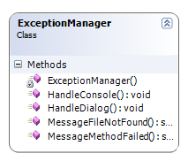
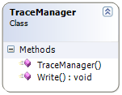
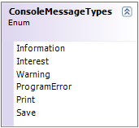

Smart.Platform.Diagnostics
Tracing
Console

Slide 10
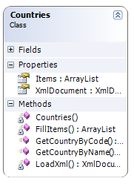
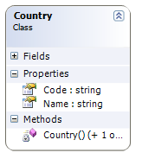
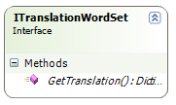
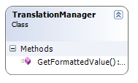
Smart.Platform.Globalization
Countries
Translation

Slide 11
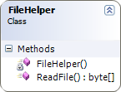
Smart.Platform.IO

Slide 12
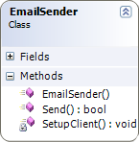
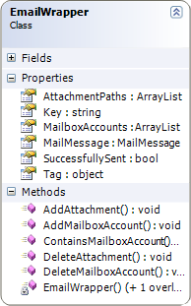
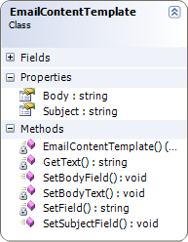
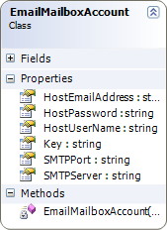
Smart.Platform.Net
Email

Slide 13
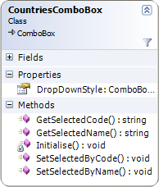
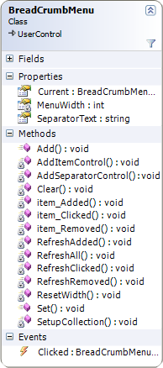
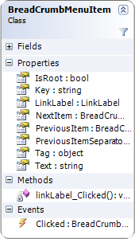
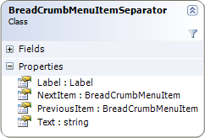
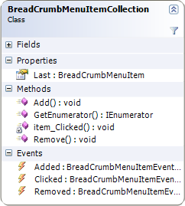

Smart.Platform.Windows
Forms

Slide 14
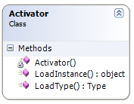
Smart.Platform.Reflection
Activation

Slide 15
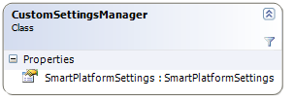
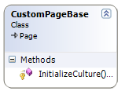
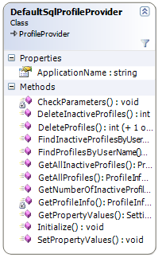
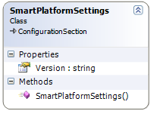
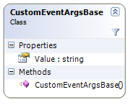
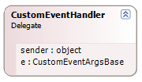
Smart.Platform.Web
WebConfig
UI
Users
Pages
Profiles
CustomEvents

Slide 16
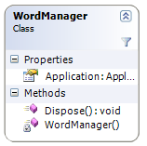
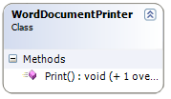
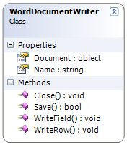
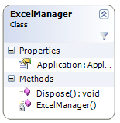
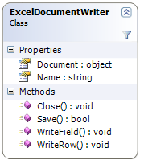
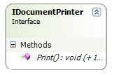
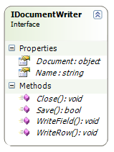
Smart.Platform.Microsoft
Interop
Word
Excel

Slide 17
Word.
Application
Word.
Document
Word.
Application
Word.
Document
Word.
Field
New
Visible = False
Fields.Item(n)
Create Word Document
Edit & Print Word Document
Documents.Add
New
Select
Selection.TypeText
(value)
SaveAs(FilePath)
PrintOut
Close
Quit

Slide 18

Data Layer
Data Management Policies
Data Access Strategies
Load Data Collection
Save Data Collection
Data Collection
Create New Item
Add Item
Remove Item
Copy Item
Currently Selected Item
Do Data Load
Do Data Insert
Do Data Update
Do Data Delete
Load
Insert
Update
Delete
Management
Access
Public
Administration
Public
Observers
Data Structure
Add Item to Collection
Remove Item from Collection
Get Item from Collection
Sort Items
Collection Data Type
Collection Parent
Fire Item Added Event
Fire Item Edited Event
Fire Item Deleted Event
Undo
Item ID
Item Data Type
Item Tag
Item Status
Item Parent Collection
Get Item Property
Set Item Property
Validate All Item Properties
Undo
Internal
Item
Collection
Events
Internal
Observers

Slide 19
IDataAccess
Strategy
IDataItem
Collection
IDataItem
GetNewItem()
ID()
Insert()
AddItem()
Node()
Create Word Document
IData
Administrator
Update(Item)
RemoveItem()
DataType()
Update(Collection)
GetItem()
Tag()
Load()
Delete()
DataType()
Parent ()
Setup
Load(ID)
Select()
DataAdministrator()
GetProperty
ToEnum
SortBy(propertyEnum)
SetProperty
Select(ID)
ToKey
Save()
ValidateAllProperties
DataIsLoaded()
Status()
SetAttribute
DataIsSaved()
IDataManagementPolicy
HistoryVersion()
Items()
History()
GetNewItem()
Initialise
Copy()
DataAdministrator
AfterDataItemStatusChanged
IsValid(propertyEnum, Value)
AddItem()
Item added;
Pending until commit
Save item immediately
Save all items immediately
Item removed;
Pending until commit
Save item immediately
Save all items immediately
Item status modified;
Pending until commit
Save item immediately
Save all items immediately
[Property Getter/Setter]
RemoveItem()
IsValid[Property]()
CopyItem()
DoEvents
GetPropertyKeys
Remove
SelectedItem()
GetPropertyEnums
EndCreate
DoSaves
DoValidations

Slide 20

Smart.Platform.Data
IComparer
New (
XmlDocument/Node, IDataItemCollection, DefaultCultureInfo)
New (
XmlDocument, IDataAdministrator, DefaultCultureInfo)
DataItem
ComparerBase
Oracle
MySQL
MS Office Access
Xml
DataItem
Base
DataItem
CollectionBase
DataAdministrator
Base
SQLServer
Events
Events
Events
SQLHelper
Interfaces
DataAccessStrategies
IDataAdministrator
DataManagementPolicies
DataAccessStrategies
SQL[Custom]Data
ManagementPolicy
SQL[Custom]Data
AccessStrategy
IDataItem
Collection
IDataAccess
Strategy
IDataManagementPolicy
IDataItem
New (
IDataAdministrator)
New ( ConnectionString)
New (
IDataAccessStrategy, IDataManagementPolicy,
DefaultCultureInfo)
Application Layer
[Application Settings] ConnectionString
Application
Oracle
MS Office Access
SQLServer
MySQL
Xml

Slide 21
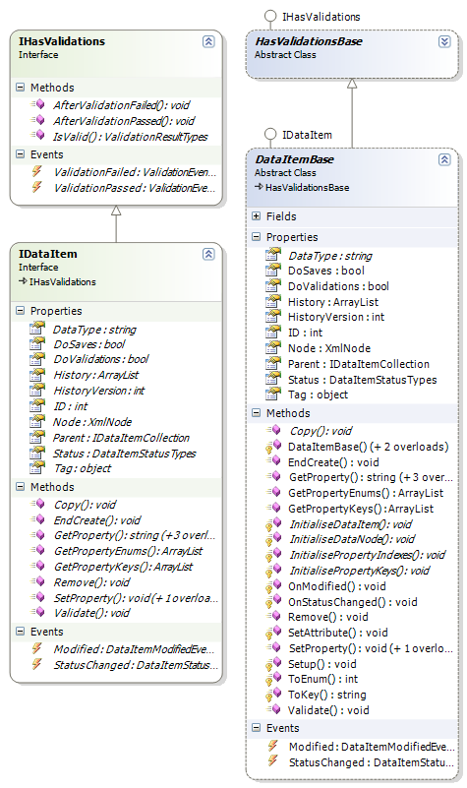

Slide 22
DataItem
Base
IDataItem
Collection
Xml
Document
XmlNode
Concrete
DataItem
New(XmlDocument,
IDataItemCollection
CultureInfo)
CreateNode
New
Status = New
HistoryVersion = 1
isDataCreated = false
The isDataCreated flag is simply used to indicate whether the Xml node has been committed to the Xml document. This will be false unless an existing Xml node is passed in or EndCreate() is called.
New(XmlNode
IDataItemCollection
CultureInfo)
Setup()
Status = Unmodified
HistoryVersion = 1
isDataCreated = true
Setup()

Slide 23
DataItem
Base
IDataItem
Collection
Xml
Document
XmlNode
Concrete
DataItem
Protected: Setup()
Protected: InitialiseDataNode
Set node attributes to default values
Protected: InitialiseDataItem
Setup foreign key helpers
Protected: InitialisePropertyIndexes
Specify start and end indexes for the property enum values
Protected: InitialisePropertyKeys
Populate a dictionary of property keys and enum values
Set culture information
EndCreate()
DocumentElement.AppendChild(XmlNode)
isDataCreated = true

Slide 24
DataItem
Base
IDataItem
Collection
Xml
Document
XmlNode
Concrete
DataItem
GetProperty(
propertyEnum,
CultureInfo)
ToKey(propertyEnum)
GetProperty(
Key, CultureInfo)
Value
GetProperty(
Key, CultureInfo)
Attributes[Key]
XmlAttribute
XmlAttribute.Value
Format value for output culture
Value

Slide 25
DataItem
Base
IDataItem
Collection
Xml
Document
XmlNode
Concrete
DataItem
SetProperty(Key, Value, SetWhenInvalid)
Modified = true
propertyEnum = ToEnum(Key)
[IF doValidations = true]
IsValid(propertyEnum, Value)
ValidationResult
Perform validation
[IF ValidationResult = Passed]
Attributes[Key].Value = Value
AfterValidationPassed(propertyEnum,
[validation passed message], ValidationResult)
[IF ValidationResult = Warning]
Attributes[Key].Value = Value
AfterValidationPassed(propertyEnum,
[validation warning message], ValidationResult)
[IF ValidationResult = Failed]
[IF setWhenInvalid = true]
Attributes[Key].Value = Value
[ELSE]
Modified = false
AfterValidationFailed(propertyEnum,
[validation failed message], ValidationResult)
[ELSE]
Attributes[Key].Value = Value
Raise Modified event
Status = Modified

Slide 26
DataItem
Base
IDataItem
Collection
Xml
Document
XmlNode
Concrete
DataItem
SetProperty(
propertyEnum, Value
SetWhenInvalid)
ToKey(propertyEnum)
SetProperty(
Key, Value, SetWhenInvalid)
AfterValidationPassed(
propertyEnum,
message, ValidationResult)
Raise ValidationPassed event
AfterValidationFailed(
propertyEnum,
message, ValidationResult)
IHasValidations.Reset()
Raise ValidationFailed event
IHasValidations.Reset()

Slide 27
DataItem
Base
IDataItem
Collection
Xml
Document
XmlNode
Concrete
DataItem
Validate()
[FOR startEnumIndex TO endEnumIndex]
GetProperty(propertyEnum)
SetProperty(propertyEnum,
Value, SetWhenInvalid = false)
IsValid(propertyEnum, Value)
IsValid(propertyEnum, Value)
ValidationResult
Result = IsValid
[Property](Value)

Slide 28
DataItem
Base
IDataItem
Collection
XmlNode
Undo()
Pop last history from the history stack
[IF history is NOT null THEN]
InnerXml
String
Current InnerXml = history InnerXml
[ELSE]
Remove()

Slide 29
DataItem
Base
IDataItem
Collection
Xml
Document
XmlNode
Concrete
DataItem
Copy(IDataItem)
Copy(IDataItem)
DoValidations = false
Copy each item from the specified IDataItem object
DoValidations = true
Remove()
[IF isDataCreated = true]
Status = Deleted
GetPropertyKeys()
Values = new ArrayList
[FOR startEnumIndex TO endEnumIndex]
ArrayList
Values.Add(ToKey(propertyEnum))
GetPropertyEnums()
Values = new ArrayList
[FOR startEnumIndex TO endEnumIndex]
ArrayList
Values.Add(propertyEnum)

Slide 30
DataItem
Base
IDataItem
Collection
Xml
Document
XmlNode
Concrete
DataItem
SetAttribute(Key, Value)
Attributes[Key]
XmlAttribute
[IF attribute = null]
CreateAttribute(Key)
XmlAttribute
Append(XmlAttribute)
XmlAttribute.Value = Value
ToKey(
propertyEnumValue)
[FOR EACH key IN propertyKeys]
Item = _keys[Key]
[IF Item = propertyEnumValue THEN]
Return Key
ToEnum(KeyValue)
[FOR EACH key IN propertyKeys]
Item = _keys[Key]
[IF Key = KeyValue THEN]
Return Item

Slide 31
DataItem
Base
IDataItem
Collection
Xml
Document
XmlNode
Concrete
DataItem
Property[Getter]
Attributes[Property
Key].Value
String
Parse value to required type
Value
Property[Setter]
SetProperty(propertyKey, Value.ToString())

Slide 32
DataItem
Base
IDataItem
Collection
Xml
Document
XmlNode
Concrete
DataItem
Status[Getter]
Attributes[statusPropertyKey].Value
String
Parse value to Status enum type
Value
Status[Setter]
SetAttribute(statusPropertyKey, Status.ToString())
Raise StatusChanged event

Slide 33


foundation8 ©
Threats
Weaknesses
Software
Opportunities
Product Framework
Languages
Innovation
Smart Platform™
Tools
Line-of-Business
Knowledge
Objectives
Products
Behaviour
Skills
Case-studies &
“Success Stories”
Aptitude
Reinforcement
Methodologies
Procedures
Development
Standards
Architecture Design
Database Design
User Interface
Value
Design
Style

Slide 34
Serialization Pattern
ISerializable
ICollection
Smart.Platform.Xml.Serialization
<Serializable()>
<XmllInclude(SerializableChildConcreteClassA)>
<XmllInclude(SerializableChildConcreteClassB)>
<XmlIgnore(Parent)>
<Serializable()>
<XmllInclude(SerializableChildBaseClass)>
Serializable
ChildBaseClass
Initialise()
*..1
Serializable
ParentClass
Initialise()
Serialization
Manager
1..1
<Serializable()>
<XmlIgnore(Parent)>
<Serializable()>
<XmlIgnore(Parent)>
SerializableChild
ConcreteClassA
Initialise()
SerializableChild
ConcreteClassB
Initialise()
1..*
Serializable Collection

Slide 35
Serialization
Manager
XmlSerializer
Memory
Stream
Serialization
Manager
XmlSerializer
Memory
Stream
Serialize(Serializable
ParentClass)
Deserialize(String)
New(GetType(
ISerializable)))
New(GetType(
ISerializable)))
New()
Byte[] = Convert.FromBase64String(String)
Serialize(MemoryStream, ISerializable)
New(Byte[])
ToArray
Deserialize(Memory Stream)
Array of Byte
Close
Object
Serializable
ParentClass
Close
String = Convert.ToBase64String(Byte[])
String

Slide 36
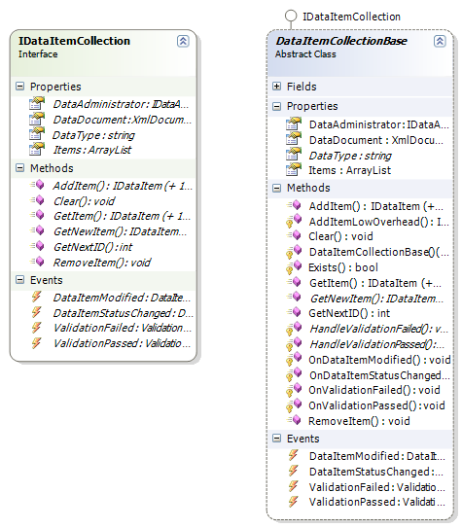

Slide 37
DataItem
CollectionBase
IDataItem
Xml
Document
IData
Administrator
ConcreteData
ItemCollection
New(
IDataItemAdministrator
CultureInfo)
New(New XmlDocument()
IDataItemAdministrator
CultureInfo)
New(XmlDocument
IDataItemAdministrator
CultureInfo)
_items = new ArrayList()
[IF XmlDocument documentElement = null THEN]
LoadXml([empty Xml schema]
[FOR EACH node in childNodes]
Item = GetNewItem(node)
AddItemLowOverhead(item)

Slide 38
DataItem
CollectionBase
DataItem
ComparerBase
ArrayList
IDataItem
SortBy(propertyEnum, ascending)
New(propertyEnum)
Sort(comparer)
[IF ascending = false THEN]
Reverse()
items
Undo()
[FOR EACH item IN items]
Get item
IDataItem
Undo()

Slide 39
DataItem
CollectionBase
IDataItem
Xml
Document
IData
Administrator
ConcreteData
ItemCollection
AddItem()
Item = GetNewItem(node)
AddItem(item)
AddItem(item)
AddItemLowOverhead(item)
Raise event DataItemStatusChanged
Protected: AddItem
LowOverhead(item)
Add event handlers for item events;
StatusChanged
ValidationPassed
ValidationFailed
_items.Add(item)
EndCreate()

Slide 40
DataItem
CollectionBase
IDataItem
Xml
Document
IData
Administrator
ConcreteData
ItemCollection
GetItem(ID)
[FOR EACH item in _items]
[IF item.ID = ID]
Return item
IDataItem
GetItem(propertyEnum, Value)
[FOR EACH item in _items]
GetProperty(
propertyEnum)
[IF propertyValue = Value]
Return item
IDataItem

Slide 41
DataItem
CollectionBase
IDataItem
Xml
Document
IData
Administrator
ConcreteData
ItemCollection
RemoveItem(IDataItem)
_items.Remove(IDataItem)
Remove
Raise event DataItemStatusChanged
Clear()
[FOR EACH item in _items]
RemoveItem(item)
GetNextID()
Highest = 0
[FOR EACH item in _items]
ID
[IF ID >= Highest THEN]
Highest = ID
Return Highest + 1

Slide 42
DataItem
CollectionBase
IDataItem
Xml
Document
IData
Administrator
ConcreteData
ItemCollection
Protected: Exists(ID)
[FOR EACH item in _items]
ID
[IF item ID = ID THEN]
Return true
Return false

Slide 43
DataItem
CollectionBase
Data
ComparerBase
ArrayList
IDataItem
SortBy(propertyEnum, ascending)
New(
propertyEnum)
_items: Sort(comparer)
Compare(
IDataItem, IDataItem)
GetProperty(propertyEnum)
String
GetProperty(propertyEnum)
String
Try to parse the value to comparable types:
Numeric
Date
String
Integer
[IF NOT ascending THEN]
Reverse

Slide 44
DataItem
CollectionBase
IDataItem
Xml
Document
ConcreteData
Item
ConcreteData
ItemCollection
New(XmlDocument,
IDataItemCollection
CultureInfo)
GetNewItem()
nextID = GetNextID()
ID = nextID
IDataItem
New(XmlNode,
IDataItemCollection
CultureInfo)
GetNewItem(XmlNode)
IDataItem
GetNewItem(DataRow)
Item = GetNewItem()
[FOR EACH column in DataRow Table.Columns]
SetProperty(ColumnName, DataRow[ColumnName].Value, false)
IDataItem

Slide 45
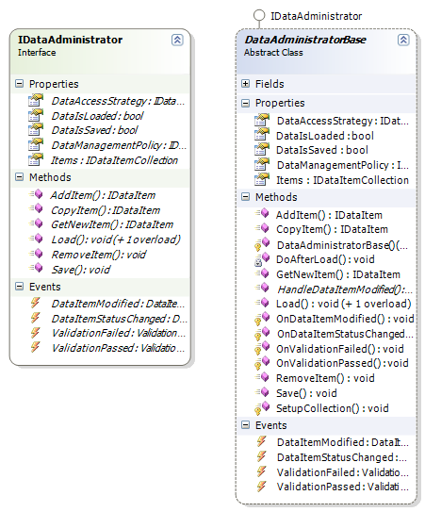

Slide 46
DataAdministratorBase
IDataManagementPolicy
ConcreteDataAdministrator
IDataItem
Collection
IDataItem
New(
IDataManagementPolicy,
IDataAccessStrategy,
CultureInfo)
New(
IDataManagementPolicy,
IDataAccessStrategy,
CultureInfo)
Initialise(IDataAdministrator)
SetupCollection(IDataItemCollection)

Slide 47
DataAdministratorBase
IDataManagementPolicy
IDataAccess
Strategy
IDataItem
Collection
IDataItem
Load()
Select(
IDataItemCollection)
IDataItemCollection
DoAfterLoad()
Load(ID)
Select(
IDataItemCollection, ID)
IDataItemCollection
DoAfterLoad()
Private: DoAfterLoad()
_dataIsLoaded = true
Write message to console

Slide 48
DataAdministratorBase
IDataManagementPolicy
IDataAccess
Strategy
IDataItem
Collection
IDataItem
Save()
Commit(
IDataItemCollection)
DoAfterSave()
Private: DoAfterSave()
_dataIsSaved = true
Write message to console

Slide 49
DataAdministratorBase
IDataManagementPolicy
IDataAccess
Strategy
IDataItem
Collection
IDataItem
GetNewItem()
GetNewItem()
IDataItem
IDataItem
AddItem(IDataItem)
AddItem(IDataItem)
IDataItem
IDataItem
RemoveItem(IDataItem)
RemoveItem(IDataItem)
CopyItem(IDataItem)
Node.Clone()
XmlNode
GetNewItem(XmlNode)
IDataItem
IDataItem

Slide 50
DataAdministratorBase
IDataManagementPolicy
IDataAccess
Strategy
IDataItem
Collection
IDataItem
Protected: SetupCollection(
IDataItemCollection)
Add event handlers for collection events;
DataItemModified
DataItemStatusChanged
ValidationPassed
ValidationFailed

Slide 51






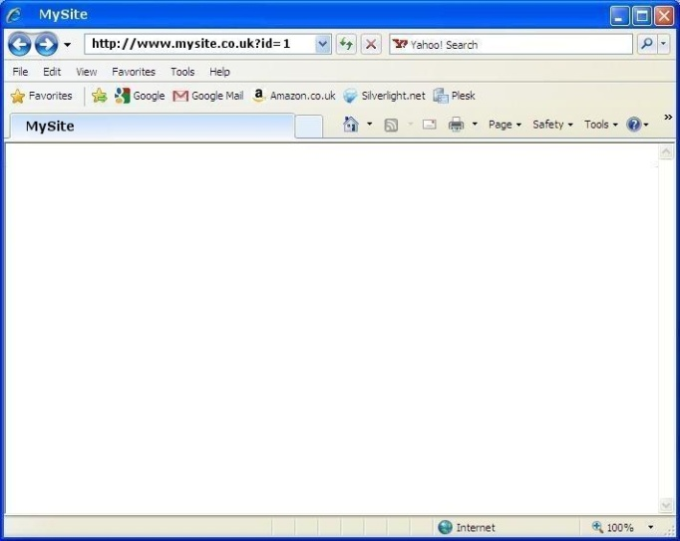




Client Environment
Data Storage Environment
Http Request
Client Side
Client
Data Stores
Server Side
Cookies
Data Access
Web Site Host Environment
Web Browser
.NET Class Libraries
Web Server
Http Response
ASP.NET Application Context
JavaScript
Silverlight Controls
Consume Public Methods
Web Services

Slide 52
Client Side
Server Side
Client Environment
Remote Environment
Offline Cache
User Management
Data Access
Windows Applications
Client Application Services Web Service
Client
User Management
Web
Applications

Slide 53
Client Side
Server Side
Client Environment
Http Request
Remote Environment
Client
Http Response
Asynchronous Reply
ASP.NET
Application
Context
ASP.NET
JavaScript
Web Service
Asynchronous Invoke
Full Page Postback

Slide 54

ComboBox
Smart.Platform.Globalization.Countries
Smart.Platform.Windows
Forms
Countries
Countries
ComboBox
1..*
Countries Data Resource Files
Country

Slide 55
Countries
ComboBox
ComboBox
Countries
Country
DropDownStyle = ComboBoxStyle.DropDownList
New()
Items.Clear()
Items
ArrayList
[FOR EACH country IN Items]
Name
String
Items.Add(Name)

Slide 56
Countries
ComboBox
ComboBox
Countries
Country
SetSelected
ByCode(countryCode)
[FOR EACH item IN ComboBox items]
GetCountryByName(item)
String
Code
String
[IF code = countryCode THEN]
Select item

Slide 57
Countries
ComboBox
ComboBox
Countries
Country
SetSelected
ByName(countryName)
[FOR EACH item IN ComboBox items]
[IF item = countryName THEN]
Select item

Slide 58
Countries
ComboBox
ComboBox
Countries
Country
GetSelectedCode
SelectedValue
Name = String
GetCountryByName(name)
String
Code
String
String
GetSelectedName
SelectedValue
String
Name = String

Slide 59
DropDownList
Smart.Platform.Globalization.Countries
Smart.Platform.Web
UI.WebControls
Countries
Countries
DropDownList
1..*
Countries Data Resource Files
Country

Slide 60
Countries
DropDownList
DropDownList
Countries
Country
New()
Items.Clear()
Items
ArrayList
[FOR EACH country IN Items]
Name
String
Code
String
Items.Add(
new ListItem(country.Name, country.Code))
Store new ListItem in dictionaries where;
1/ Code is key
2/ Name is key

Slide 61
Countries
DropDownList
DropDownList
Countries
Country
SetSelected
ByCode(countryCode)
Get ListItem from dictionary where code is key
Set ListItem selected
SetSelected
ByName(countryName)
Get ListItem from dictionary where name is key
Set ListItem selected

Slide 62
Countries
DropDownList
DropDownList
Countries
Country
GetSelectedCode
String
Code = SelectedItem.Value
GetSelectedName
String
Name = SelectedItem.Text

Slide 63
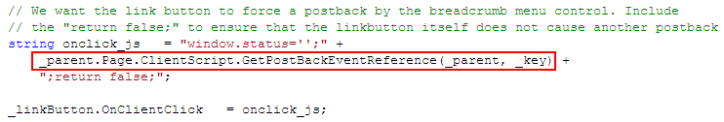
The first argument is the control which is triggering the postback. The second argument is the ‘event argument’ value
This is included to suppress the javascript from appearing in the status bar of the browser

Slide 64
IDataItemCollectionDisplayStrategy
IDataItemCollectionScreenManager
IDataItemCollectionWinFormsForm
Display(items)
This is where the knowledge of the UI is abstracted.
Manage the activity of the UI, maintain the correct screen state. There should be no awareness of the type of the UI. Delegate actual UI processing to the display strategies
New(dataManager, logicManager, screenManager)
SetScreenState()
This should be just a skin, so not aware of any logic or UI specific handling. Delegate operations out to the logic manager.
GetSelected()
Display(items)
SetSelected(item)
GetSelected()
RefreshView()
DoAdd(object[] params)
SetSelected(item)
DisplaySortTypes(ArrayList)
Items()
DoEdit(item, object[] params)
DisplaySortTypes(ArrayList)
GetSelectedSortType
Params()
SetAllowAdd(value)
GetSelectedSortType
DoAdd(object[] params)
DoEdit(item, object[] params)
SetAllowEdit(value)
SetAllowDelete(value)
SetAllowAdd(value)
IDataItemCollectionASPPage
SetAllowEdit(value)
IDataItemCollectionLogicManager
SetAllowDelete(value)
RefreshList()
Encapsulate the logic for the functions which are available to the user through the UI. Therefore, there should be no awareness of the type of UI. Delegate the actual handling of the UI to the screen manager
Private: Setup()
DoSelected(item)
DoAdd()
DoEdit()
DoDelete()
DoSort()???
DoOk()
DoCancel()

Slide 65
IDataItemDisplayStrategy
IDataItemLogicManager
IDataItemWinFormsForm
New(dataManager, logicManager, screenManager)
Display(item)
This is where the knowledge of the UI is abstracted.
RefreshAll()
Manage the activity of the UI, maintain the correct screen state. There should be no awareness of the type of the UI. Delegate actual UI processing to the display strategies
This should be just a skin, so not aware of any logic or UI specific handling. Delegate operations out to the logic manager.
Fill(item)
Private: Initialise()
SetAllowOk()
DoOk()
DoCancel()
IDataItemScreenManager
RefreshView()
Encapsulate the logic for the functions which are available to the user through the UI. Therefore, there should be no awareness of the type of UI. Delegate the actual handling of the UI to the screen manager
Item()
SetScreenState()
Params()
Display(item)
IDataItemASPPage
Fill(item)
SetAllowOk()

Slide 66
Smart.Platform.View
ASP.NET
WPF
DataItemDialog
ScreenManager
Base
DataItemCollection
DialogScreen
ManagerBase
WinForms
DataItemDialog
StrategyBase
DataItemCollectionDialog
StrategyBase
Interfaces
IDataItemDialog
ScreenManager
IDataItemDialog
Strategy
IDataItem
CollectionDialog
ScreenManager
IDataItem
CollectionDialog
Strategy
DataAccessStrategies
Smart.Platform.Application
Interfaces
IDataItemDialog
LogicManager
IDataItemCollectionDialogLogic
Manager
DataItemCollectionDialogLogicManagerBase
DataItemDialog
LogicManagerBase
Application
Context
[Application Settings] Strategy class names

Slide 67
Application Layer
Data Item Dialog
Start-up application
Shut-down application
User configuration
Wire up run-time strategy implementations
Display item
Update item
Load item data
Handle validation
Commit or cancel item editing
Save item data
Set dialog state
Enable or disable buttons
Create new item
Edit item
Delete item
Logic Management
Application Context
Application Implementation
Data Layer
View Layer
Data Item Collection Dialog
Events
Load collection data
Get a count of items
Number of items per page
Display number of pages
Display page of items
Sort the items
Logic Management

Slide 68
Smart.Platform.Application
Interfaces
IDataItemDialog
LogicManager
IDataItemCollectionDialogLogic
Manager
DataItemCollectionDialogLogicManagerBase
DataItemDialog
LogicManagerBase
Application
Context
[Application Settings] Strategy class names
Smart.Platform.View
ASP.NET
WPF
WinForms
IDataItemDialog
ScreenManager
IDataItemCollection
DialogScreenManager
DataItemDialog
StrategyBase
DataItemCollectionDialogStrategyBase

Slide 69
DataItemDialogLogicManagerBase
New(IDataAdministratorProvider,
IDataItemDialogScreenManager)
_dataManager = dataManager
_screenManager = screenManager

Slide 70
DataItemDialogLogicManagerBase
IDataDialogDialog
ScreenManager
ISelectedItem
Provider
IData
Administrator
SetStateNew
_stateNewYN = true
_stateEditYN = false
DoNew()
SetDialogReadOnly(false)
SetStateEdit
_stateNewYN = false
_stateEditYN = true
DoEdit()
SetDialogReadOnly(false)
SetStateDelete
_stateNewYN = false
_stateEditYN = false
DoDelete()
SetDialogReadOnly(true)
SetStateNone
_stateNewYN = false
_stateEditYN = false
SetDialogReadOnly(true)

Slide 71
DataItemDialogLogicManagerBase
IDataDialogDialog
ScreenManager
ISelectedItem
Provider
IData
Administrator
IDataItem
DoNew
previousItem = _item
SingleItemDataAdministrator
Initialise()
GetNewItem()
IDataItem
AddItem(_item)
InitialiseNewItem(_item, previousItem)
DoEdit
SelectedItem
IDataItem
SingleItemDataAdministrator
Load(selectedItem.ID)
Items.GetItem(selectedItem.ID)
IDataItem
DoDelete
SelectedItem
IDataItem
SingleItemDataAdministrator
Load(selectedItem.ID)
Items.GetItem(selectedItem.ID)
IDataItem
Remove
Save

Slide 72
DataItemDialogLogicManagerBase
IDataDialogDialog
ScreenManager
ISelectedItem
Provider
IData
Administrator
Save
SingleItemDataAdministrator
Save()
DisplayItem(item)
DisplayItem(item)
This method may be overridden to extend the functionality for displaying foreign key items
_item = item
UpdateItem(item)
UpdateItem(item)
We may not want the user to click save if there are any failed validations on the user interface
SetButtonsEnabled(save)
[IF _stateEditYN = true THEN]
newYN = false, editYN = false
saveYN = save, deleteYN = false
cancelYN = true
[ELSE IF _stateNewYN = true THEN]
newYN = true, editYN = false
saveYN = save, deleteYN = false
cancelYN = true
[ELSE]
SelectedItem
IDataItem
newYN = true, editYN = (item != null)
saveYN = false, deleteYN = (item != null)
cancelYN = false
SetButtonsEnabled(newYN, editYN, deleteYN, saveYN, cancelYN)

Slide 73
DataItemCollection
DialogLogicManagerBase
New(IDataAdministratorProvider,
IDataItemDialogScreenManager)
_dataManager = dataManager
_screenManager = screenManager

Slide 74
DataItemCollectionDialogLogicManagerBase
IDataItemCollection
DialogScreenManager
IDataAdministrator
Load(selectedPage, selectedSortBy)
_selectedPage = selectedPage
Determine fromRowNumber & toRowNumber
ManyItemsDataAdministrator
LoadItemsBetween(
fromRowNumber, toRowNumber, selectedSortBy)
RefreshCount
ManyItemsDataAdministrator
CountAll
int

Slide 75
DataItemCollectionDialogLogicManagerBase
IDataItemCollection
DialogScreenManager
IDataAdministrator
PopulatePages(
selectedPage)
_selectedPage = selectedPage
PopulatePages(selectedPage)
DisplayNumberofItems(
firstItem, lastItem, numberofItems)
DisplayNumberofItems(
firstItem, lastItem, numberofItems)

Slide 76
DataItemCollectionDialogLogicManagerBase
IDataItemCollection
DialogScreenManager
PopulateSortBy(
selectedSortBy)
Abstract: GetSortByItems
PopulateSortBy(sortTypes, selectedSortBy)

Slide 77
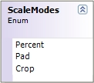
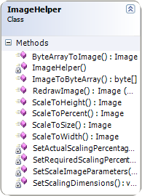
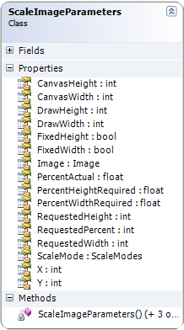
Smart.Platform.Drawing

Slide 78
View Layer
Data Item Dialog
Set the current screen state
Display an item on the screen
Fill an item from the screen
Set dialog readonly
Screen Management
User
Application Layer
Data Item Collection Dialog
Set the current screen state
Display items on the screen
Get the selected item
Set the selected item
Display sorting options
Get the selected sort
Display a paging control
Display number of items
Screen Management

Slide 79
DataItemDialogScreen
ManagerBase
IDataItemDialog
DisplayStrategy
New(IDataItemDialogDisplayStrategy)

Slide 80
DataItemDialogScreen
ManagerBase
IDataItemDialog
DisplayStrategy
SetDialogReadOnly(
readOnlyYN)
SetDialogReadOnly
SetButtonsEnabled(
newYN, editYN, deleteYN,
saveYN, cancelYN)
SetButtonsEnabled
DisplayItem(IDataItem)
DisplayItem
UpdateItem(IDataItem)
UpdateItem

Slide 81
DataItemCollectionDialogScreenManagerBase
IDataItemCollection
DialogScreenStrategy
New(IDataItemCollectionDialog
ScreenStrategy)

Slide 82
DataItemCollectionDialogScreenManagerBase
IDataItemCollection
DialogScreenStrategy
DataItemCollectionDialogScreenManagerBase
IDataItemCollection
DialogScreenStrategy
PopulatePages(selectedPage)
GetSelectedSortBy
GetSelectedSortBy
PopulatePages
int
int
DisplayNumberofItems(
firstItem, lastItem, numberofItems)
GetSelectedItem
GetSelectedItem
DisplayNumberofItems
IDataItem
IDataItem
PopulateSortBy(
sortTypes, selectedSortBy)
PopulateSortBy

Slide 83
Smart.Platform.View.ASPNET

Slide 84
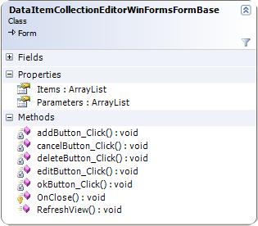
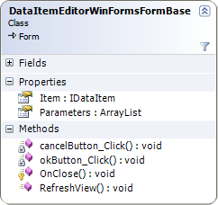
Smart.Platform.View.WinForms

Slide 85
Smart.Platform.Web.UI.WebControls
Events: Clicked
Delegate: BreadCrumb
MenuItemEventHandler
UserControl
1..*
BreadCrumb
Menu
Events
1..*
1..1
BreadCrumb
MenuItemSeparator
Page
Events: Clicked, Added, Removed
IEnumerable
Events: Clicked
BreadCrumb
MenuItemCollection
Events
BreadCrumb
MenuItem
1..*
Events

Slide 86
Smart.Platform.Windows.Forms
Events: Clicked
Delegate: BreadCrumb
MenuItemEventHandler
UserControl
1..*
BreadCrumb
Menu
Events
1..*
1..1
BreadCrumb
MenuItemSeparator
Form
Events: Clicked, Added, Removed
IEnumerable
Events: Clicked
BreadCrumb
MenuItemCollection
Events
BreadCrumb
MenuItem
1..*
Events

Slide 87
BreadCrumbMenu
BreadCrumbMenu
ItemCollection
New()
New()
Set collection event handlers:
Clicked, Added, Removed
Current()
Last()
Item
BreadCrumbMenuItem

Slide 88
BreadCrumbMenu
BreadCrumbMenu
ItemCollection
BreadCrumbMenu
Item
Set(
BreadCrumbMenu
ItemCollection)
Reset collection event handlers:
Clicked, Added, Removed
RefreshAll()
Add(
BreadCrumbMenuItem)
Set item event handlers: Clicked
Add(item)

Slide 89
Smart.Platform.Web.UI.WebControls
Smart.Platform.Windows.Forms
BreadCrumbMenu
BreadCrumbMenu
ItemCollection
BreadCrumbMenu
BreadCrumbMenu
ItemCollection
Private: RefreshAll()
Private: RefreshAll()
Clear()
Clear()
[FOR EACH item IN collection]
[FOR EACH item IN collection]
[IF 1 or more elements exist THEN]
[IF 1 or more elements exist THEN]
AddSeparatorControl(item)
AddSeparatorControl(item)
AddItemControl(item)
AddItemControl(item)
ResetWidth()

Slide 90
Smart.Platform.Web.UI.WebControls
BreadCrumbMenu
BreadCrumbMenu
ItemCollection
BreadCrumbMenu
ItemSeparator
BreadCrumbMenu
Item
Private: AddSeparatorControl(
BreadCrumbMenuItem)
New(separatorText)
PreviousItem
previousIitem
PreviousItem = previousItem
NextItem = item
PreviousItemSeparator = separator
Label
String
this.Controls.Add(separator.Label)
Add separator to elements collection

Slide 91
Smart.Platform.Windows.Forms
BreadCrumbMenu
BreadCrumbMenu
ItemCollection
BreadCrumbMenu
ItemSeparator
BreadCrumbMenu
Item
Private: AddSeparatorControl(
BreadCrumbMenuItem)
New(separatorText)
PreviousItem
previousIitem
PreviousItem = previousItem
NextItem = item
PreviousItemSeparator = separator
Label
String
MenuWidth()
Set separator label location = new Point(menuWidth, menuHeight)
this.Controls.Add(separator.Label)
Add separator to elements collection

Slide 92
Smart.Platform.Web.UI.WebControls
BreadCrumbMenu
BreadCrumbMenu
ItemCollection
BreadCrumbMenu
ItemSeparator
BreadCrumbMenu
Item
Private: AddItemControl(
BreadCrumbMenuItem)
LinkButton
LinkButton
this.Controls.Add(item.LinkButton)
Add item to elements collection
Private: item_Clicked(
BreadCrumbMenuItem)
[IF doRefresh THEN]
RefreshAfterItemClicked()
doRefresh = false
NextItem
nextItem
[WHILE nextItem != null LOOP]
Remove(item)
NextItem
nextItem
doRefresh = true
Raise event Clicked

Slide 93
Smart.Platform.Windows.Forms
BreadCrumbMenu
BreadCrumbMenu
ItemCollection
BreadCrumbMenu
ItemSeparator
BreadCrumbMenu
Item
Private: AddItemControl(
BreadCrumbMenuItem)
LinkLabel
LinkLabel
MenuWidth()
Set item label location = new Point(menuWidth, menuHeight)
this.Controls.Add(item.LinkLabel)
Add item to elements collection
Private: item_Clicked(
BreadCrumbMenuItem)
[IF doRefresh THEN]
RefreshAfterItemClicked()
doRefresh = false
NextItem
nextItem
[WHILE nextItem != null LOOP]
Remove(item)
NextItem
nextItem
doRefresh = true
Raise event Clicked

Slide 94
Smart.Platform.Web.UI.WebControls
BreadCrumbMenu
BreadCrumbMenu
ItemCollection
BreadCrumbMenu
ItemSeparator
BreadCrumbMenu
Item
Private: RefreshAfterItemClicked(
BreadCrumbMenuItem)
NextItem
nextItem
[WHILE nextItem != null LOOP]
PreviousItemSeparator
separator
Label
String
LinkButton
LinkButton
this.Controls.Remove(next.PreviousItemSeparator.Label)
this.Controls.Remove(next.LinkButton)
Remove label and link button from elements collection
NextItem
nextItem

Slide 95
Smart.Platform.Windows.Forms
BreadCrumbMenu
BreadCrumbMenu
ItemCollection
BreadCrumbMenu
ItemSeparator
BreadCrumbMenu
Item
Private: RefreshAfterItemClicked(
BreadCrumbMenuItem)
NextItem
nextItem
[WHILE nextItem != null LOOP]
PreviousItemSeparator
separator
Label
String
LinkLabel
LinkLabel
this.Controls.Remove(next.PreviousItemSeparator.Label)
this.Controls.Remove(next.LinkLabel)
Remove label and link label from elements collection
NextItem
nextItem
ResetWidth()

Slide 96
Smart.Platform.Windows.Forms
BreadCrumbMenu
BreadCrumbMenu
ItemCollection
BreadCrumbMenu
ItemSeparator
BreadCrumbMenu
Item
Private: RefreshAfterItemAdded(
BreadCrumbMenuItem)
AddSeparatorControl(item)
AddItemControl(item)
ResetWidth()
Private: RefreshAfterItemRemoved(
BreadCrumbMenuItem)
PreviousItemSeparator
separator
Remove the separator element if there is one, then remove the item element
LinkLabel
LinkLabel
width = item.LinkLabel.Width
[IF previousItemSeparator != null THEN]
this.Controls.Remove(item.PreviousItemSeparator.Label)
Remove label from elements collection
width += item.PreviousItemSeparator.Label.Width
Shuffle the items along
this.Controls.Remove(item.LinkLabel)
Remove link label from elements collection
NextItem
nextItem
[WHILE nextItem != null LOOP]
next.PreviousItemSeparator.Label.Location =
new Point(next.PreviousItemSeparator.Label.Location.X - width, menuHeight)
next.LinkLabel.Location =
new Point(next.LinkLabel.Location.X - width, menuHeight);
NextItem
nextItem
ResetWidth()

Slide 97
Smart.Platform.Windows.Forms
BreadCrumbMenu
BreadCrumbMenu
ItemCollection
BreadCrumbMenu
ItemSeparator
BreadCrumbMenu
Item
Private: item_Removed(
BreadCrumbMenuItem)
[IF doRefresh THEN]
RefreshAfterItemRemoved()
Private: item_Added(
BreadCrumbMenuItem)
[IF doRefresh THEN]
RefreshAfterItemAdded()
Private: MenuWidth()
[FOR EACH element IN _elements LOOP]
[IF element IS BreadCrumbMenuItem THEN]
LinkLabel
LinkLabel
width += element.LinkLabel.Width
[ELSE IF element IS BreadCrumbMenuItemSeparator THEN]
Label
String
width += element.Label.Width
width

Slide 98
The page lifecycle begins with invoking the HTTP Handler’s ProcessRequest() method, which builds up the control hierarchy
Control Steps
Retrieve application objects from session state
Load application data
Initialisation
Postback Steps
LoadViewState
Construct dynamic controls
LoadPostbackData
HTTP
Handler
Identify type of page load event
Initialise control content
Load
RaisePostbackEvent
Handle control events
Reload page if required
SaveViewState
The rendered markup is returned to the Web server
Render

Slide 99
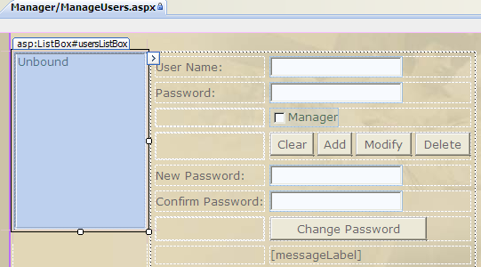
List all users from the authentication data source
When a user is selected in the list, the user name is displayed but the password is not. The actual password is never retrieved from the data source.
Implement some kind of role based level of security to prevent unauthorised users from performing user management operations. For example, only a ‘manager’ can change passwords.
The user’s password cannot be retrieved and displayed. It can simply be changed.

Slide 100
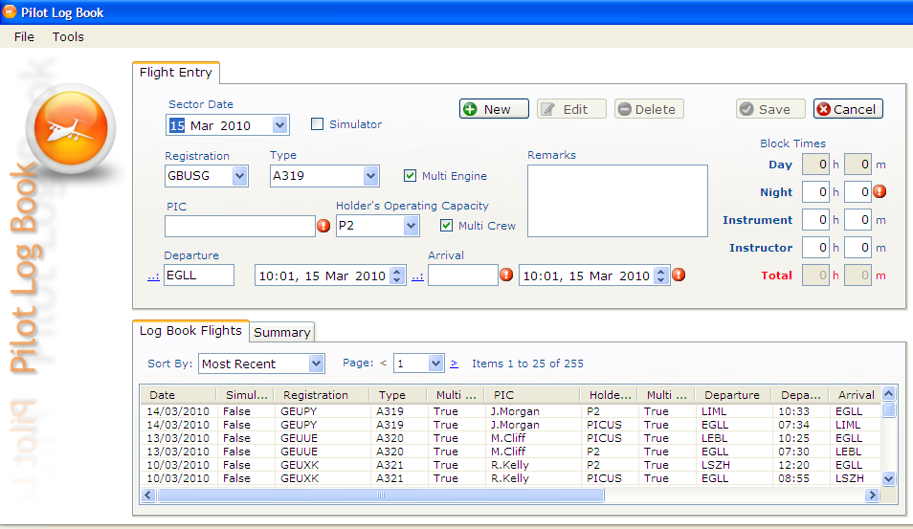
The data item dialog
The data item collection dialog

Slide 101
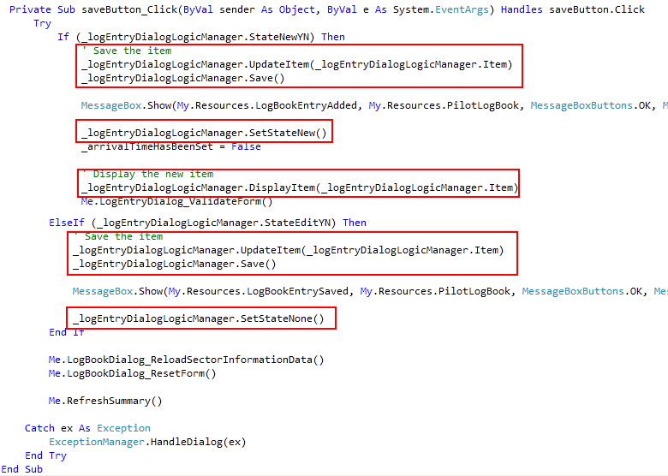
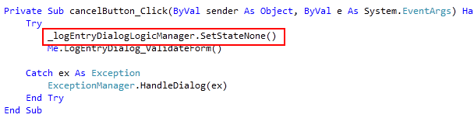
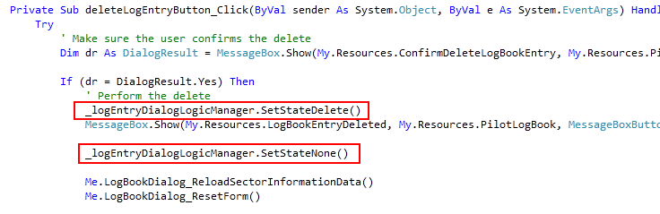

Slide 102
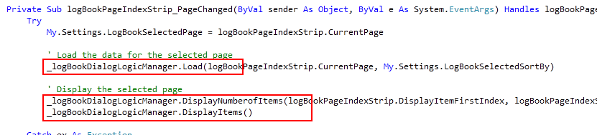
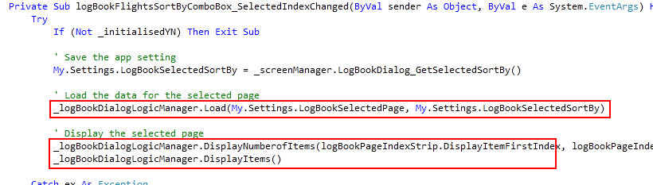

Slide 103


Client Domain
Development Domain
Validate License
Create License Request
Create License
Application Layer
Verify Signed License
Deployment
Create Public/Private Signing Keys
Decrypt License
Public Signing Key
Public/Private Signing Keys
Load License Request
Create Public/Private Encryption Keys
Create License Token
Encrypt License
Public Encryption Key
Determine License Validity
Public/Private Encryption Keys
Sign License
License.xml
License.xml

Slide 104





Limited Users
Suitable for multi-user environment, medium to large business
Expiry Time
Suitable for single-user environment, small business
Limited Users & Expiry Time
Suitable for multi-user environment, small to medium business
Limited Uses
Suitable for trial software

Slide 105



Keys
Build the software. Either;
Include signed license if expiry determined by time or usage
Exclude license if licensing per user or machine
Deploy the software
Public Signing Key
Public EncryptionKey
Client Side
Keys
Every time the application is started, perform the license validation...
Private Signing Key
Public Signing Key
Private EncryptionKey
Public EncryptionKey
...If the license exists then verify the license & determine license validity...
Deployment
Side
License.xml
Create & return a signed & encrypted license for a license request using an XML Digital Signature & XML Encryption
...But if any of this fails, then create license request & send by email or online activation
Licensing Data
...store licensing data relating to the license request
Keep a usage log (i.e. in the registry or a file)
Email
License Validation Web Service

